Slide 1
Brain Tumour Detection Using Deep Learning

Slide 2
ABSTRACT
The motivation behind this study is to detect brain tumour and provide better treatment for the sufferings. The abnormal growths of cells in the brain are called tumours and cancer is a term used to represent malignant tumours. Usually CT or MRI scans are used for the detection of cancer regions in the brain

Slide 3
EXISTING SYSTEM
Mircea Gurbin, Mihaela Lascu, and Dan Lascu et al. proposed a method consisting of Continuous Wavelet Transform (CWT), Discrete Wavelet Transform (DWT) and Support Vector Machine (SVM). It uses different levels of wavelets, and by training, the cancerous and non-cancerous tumours can be identified. The computation time is longer for the proposed method.

Slide 4
Somasundaram S. and Gobinath R. et al. explains the present status of detection and segmentation of tumour through deep learning models. For deeper segmentation, 3D based CNN, ANN and SVM is used.
Damodharan S. and Raghavan D. et al. address segmentation of pathological tissues (Tumor), normal tissues (White Matter (WM) and Gray Matter (GM)) and fluid (Cerebrospinal Fluid (CSF)), extraction of the relevant features from each segmented tissues and classification of the tumor images with Neural Network (NN).

Slide 5
DISADVANTAGES OF EXISTING SYSTEM
Owing to the small size of tumors compared to the rest of the brain, brain imaging data are imbalanced. Due to this characterization, existing networks get to be biased towards the one class that is overrepresented.
Less accuracy was achieved.
Higher false rates.
Takes more time than the usual time.
Complex in implementing real time applications.

Slide 6
PROPOSED SYSTEM
The aim of this system is to build a system that would help in brain tumour detection from MRI images through the convolution neural network. The proposed method was tested and compared with the existing classification techniques to determine the accuracy of the proposed method.

Slide 7
Deep learning is a machine learning technique that instructs computers what to do as a human think and do in a scenario. In deep learning, a computer model is able to do classification tasks from images, sound or text. Sometimes human level performance is being exceeded by deep learning techniques. One of the most popular neural networks is an artificial neural network that has a collection of simulated neurons. Each neuron acts as a node and by links each node is connected to other nodes.

Slide 8
The proposed system consists of image acquisition, preprocessing, segmentation, feature extraction and classification.
This algorithm is faster in execution for normal MRI images.

Slide 9
ADVANTAGES OF PROPOSED SYSTEM
Deep learning techniques will be effective here to classify tumour image without segmentation.
In deep learning , the feature is extracted from the entire image automatically. Convolution in the CNN architecture performs this operation. Number of feature maps increases with the increase in CONV layer.

Slide 10
Reduction of dimension is required to initiate training. Pooling layer down samples the feature dimension. Fully connected layers manipulate the score of each label. Softmax layers prepare the model with feature and class score.
CNN is proved for better accuracies with supporting to the deep learning methods. It is also complemented with the light weight library in python for image processing which help us to classify the image and improves the speed of execution. System has used various parameters for classification between normal and tumorous brain

Slide 11
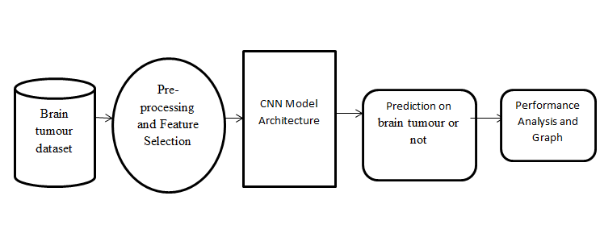
SYSTEM ARCHITECTURE

Slide 12
HARDWARE REQUIREMENTS
System : Pentium i3 Processor.
Hard Disk : 500 GB.
Monitor : 15’’ LED
Input Devices : Keyboard, Mouse
Ram : 4 GB

Slide 13
SOFTWARE REQUIREMENTS
Operating system : Windows 10.
Coding Language : Python
Web Framework : Flask

Slide 14
REFERENCE
Avigyan Sinha, Aneesh R P, Malavika Suresh, Nitha Mohan R, Abinaya D, Ashwin G Singerji, “Brain Tumour Detection Using Deep Learning”, IEEE Conference, 2021.

